Slide 1



IdeaScape:
Supporting Designers’ Ideation
Needfinding Report
Team 6
CMPSC 185
Xue Gao, Jintong Yang, Yanxiu Jin
Human-Computer Interaction

Slide 2

CMPCS 185
Team6
GR1: Needfinding
Table of Contents
Team Introduction
Problem Domain
Needfinding Methodology
Interveiw result
Analysis
Summary

Slide 3


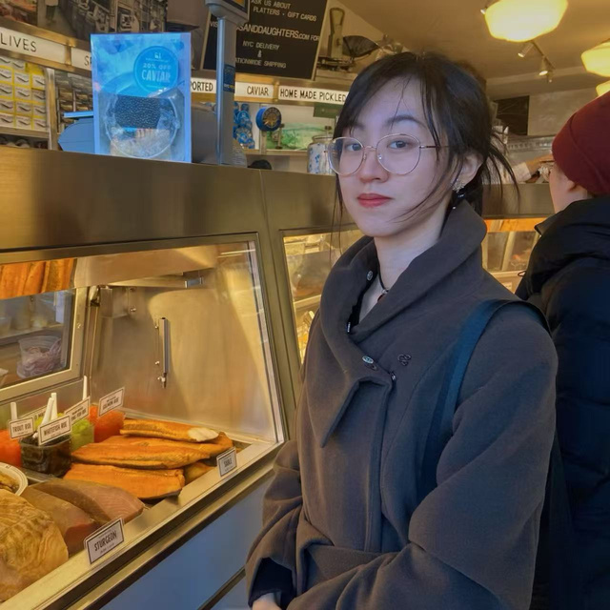
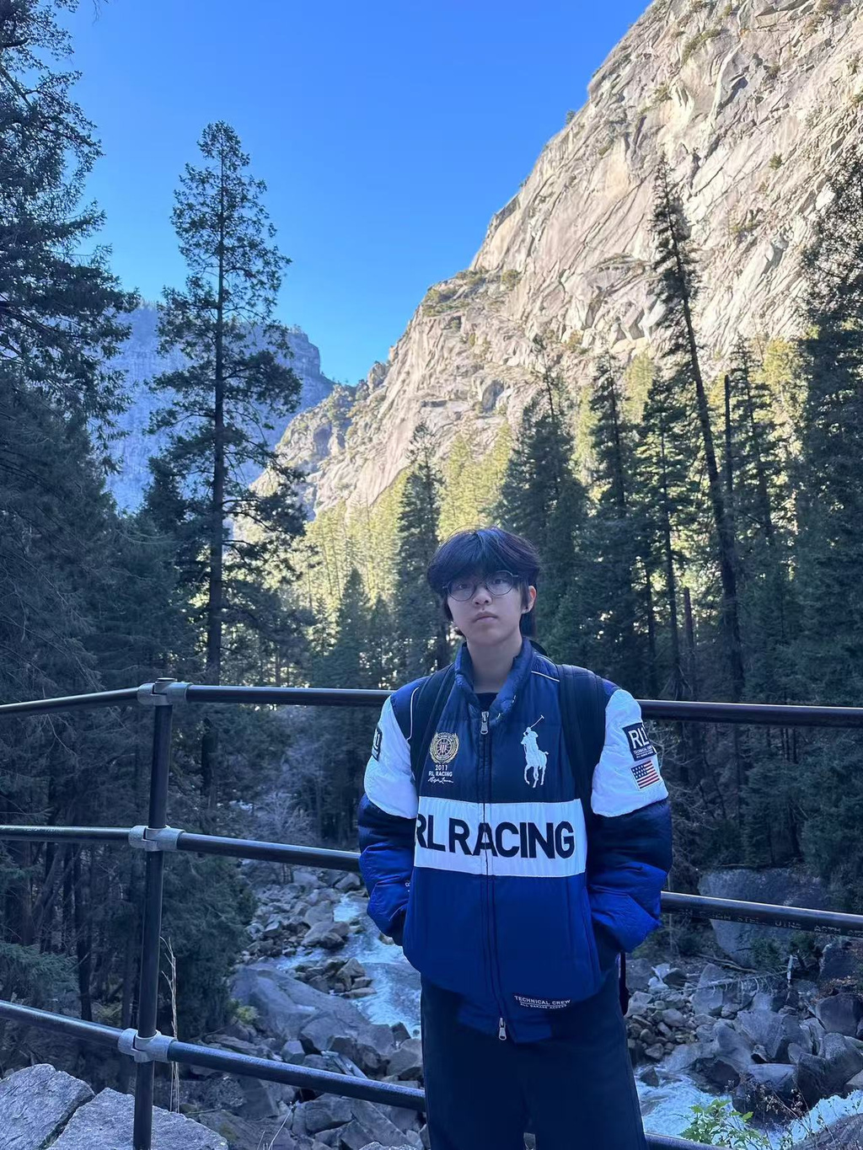

CMPCS 185
Team6
GR1: Needfinding - Team Introduction
Team Members
Xue Gao
Jintong Yang
Yanxiu Jin
MAT student
MAT student
ECE student

Slide 4
CMPCS 185
Team6
GR1: Needfinding - Problem Domain
T3: Designing for Human Agency and Control
As more products quietly automate decisions from what we see, what we click, what we buy, to what we remember, people can end up supervising systems rather than acting with intention. Sometimes that automation is helpful; other times it erodes autonomy, confidence, and accountability. This theme asks you to design tools that keep people meaningfully “in the loop,” not as a last-resort override, but as an active partner in decision-making. How might we design systems that make it easy to choose, steer, and revise automated outcomes so users remain capable, informed actors?

Slide 5
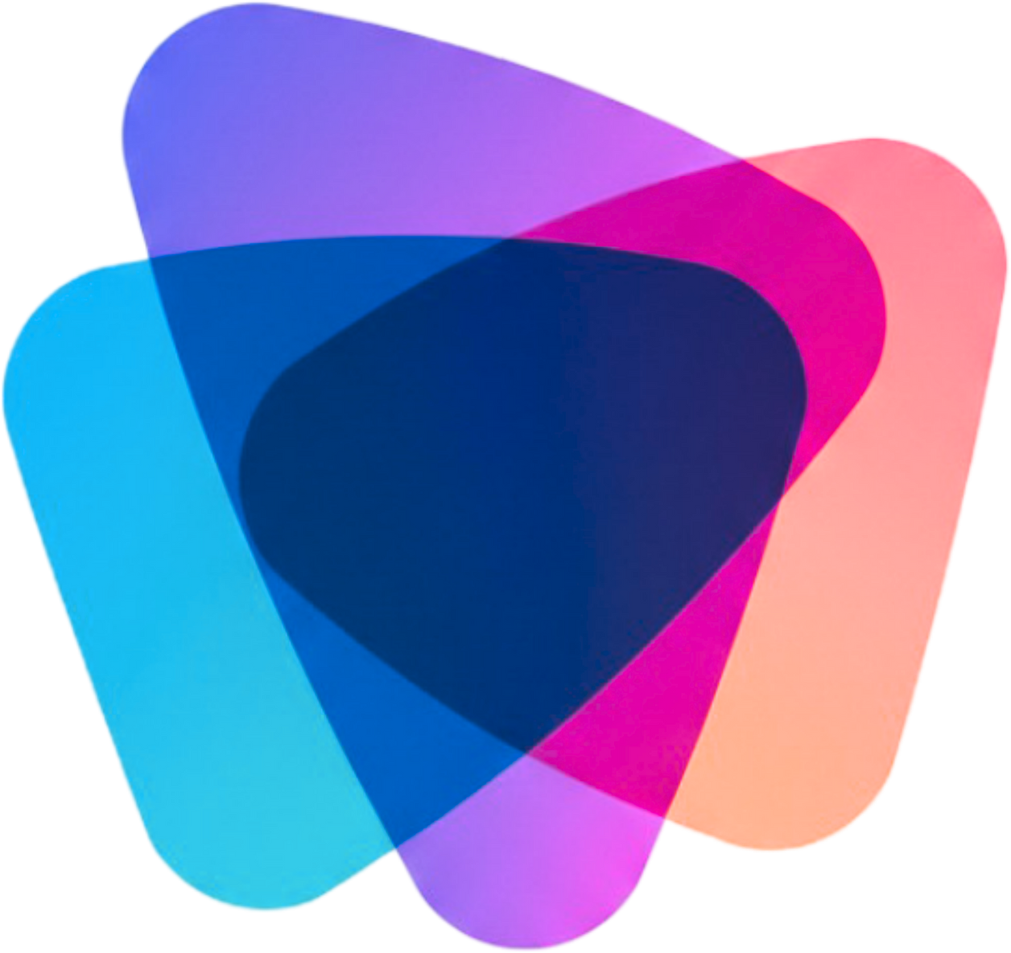
CMPCS 185
Team6
GR1: Needfinding - Problem Domain
Problem Domain
Is this a domain vulnerable to
loss of agency through automation?
Creative Design Ideation in Industry
Is this a shared everyday
professional experience?
Are we interested in it?

Slide 6

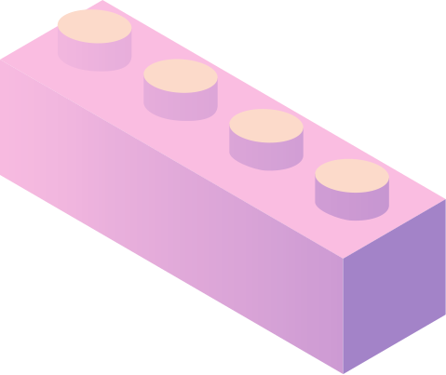
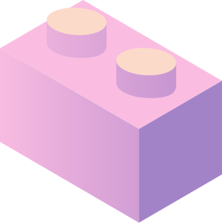
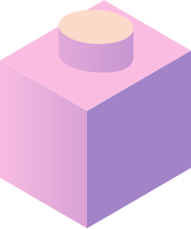
CMPCS 185
Team6
GR1: Needfinding - Needfinding Methodology
Participant Selection Factors
Current Practitioner
in Industry
Non-UCSB Student
Diversity

Slide 7
CMPCS 185
Team6
GR1: Needfinding - Needfinding Methodology
Diversity Consideration
Industry Context
Design Discipline
Organization / Operation Size
Geographic Region / Practice Region
Team Role / Position
Workflow &
Process
Age
Culture (Language)

Slide 8
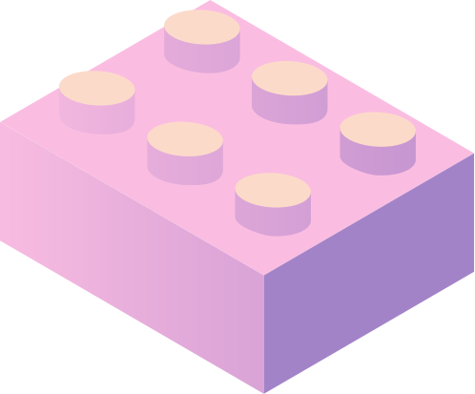
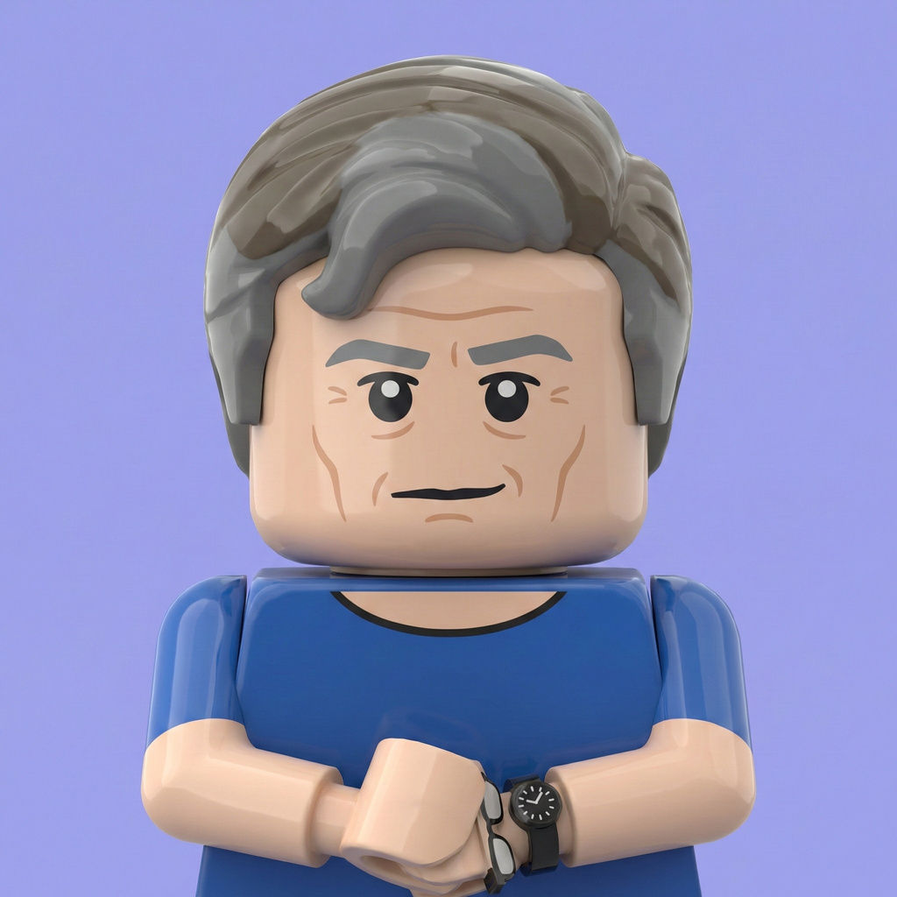
CMPCS 185
Team6
GR1: Needfinding - Needfinding Methodology
Extreme Case: Joe
He’s the owner of the manufacturing studio inherited from his family. Thus:
He has greater decision-making authority
1
He operates at a high-level, conceptual role
2
He has visibility across the entire workflow
3
His role is not linear or chain-based
4
He collaborates directly with external architects and designers
5

Slide 9
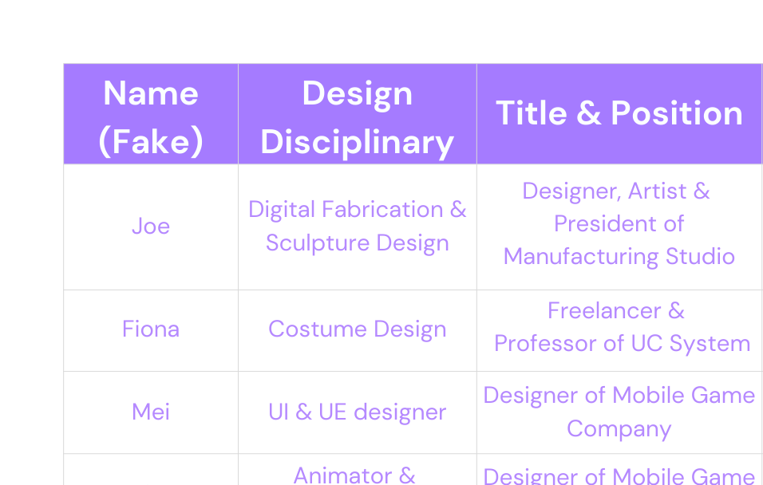
CMPCS 185
Team6
GR1: Needfinding - Needfinding Methodology
Interviewee Information
We conducted 3 semi-structured interviews with 4 interviewees for needfinding. Participants were recruited through personal and professional networks, including collaborator referrals, faculty-organized industry visits, and UCSB faculty connections. During the interview, we used Zoom and the Apple recording app to record the conversation, and use built-in post-meeting transcript generation in zoom and otter.ai for records.

Slide 10

CMPCS 185
Team6
GR1: Needfinding - Needfinding Methodology
Why are they appropriate?
All participants actively engage in creative ideation within industry settings
Their work takes place in contexts where automation tools increasingly influence how ideas are generated, evaluated, and finalized
They represent diverse design disciplines, organizational scales, and geographic regions
This diversity allows us to observe how human agency and control are maintained and exercised across real-world creative workflows

Slide 11
CMPCS 185
Team6
GR1: Needfinding - Needfinding Methodology
Interview Questions
Design & Ideation
Colaboration & Communication
AI Use
What’s your design discipline?
What’s your position?
Do you work as a freelancer, in a studio, or a company?
Do you use AI while working? How do you use it? Can you give us an example?
What’s your typical workflow?
What kind of tools do you use?
Who and how do you communicate your ideas?
How do you organize your ideas? What tools & methods do you use?
What do you enjoy and don’t enjoy in the ideation process？
How do you brainstorm ideas?
How do you get inspiration？
What are some things you feel are inconvenient or uncomfortable using AI for ideation?
How do you deal with it?
How long will the ideation phase usually take?
What are some criteria you have for you to move from ideation to the next steps?

Slide 12


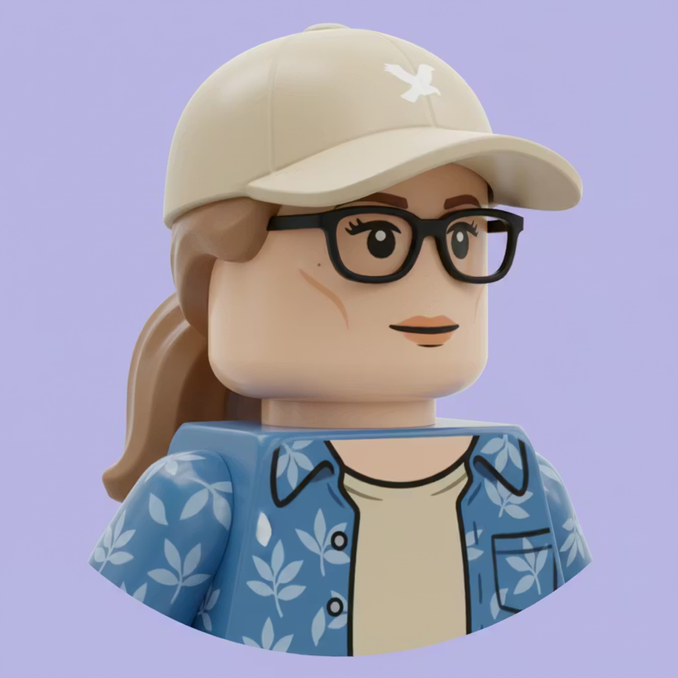

CMPCS 185
CMPCS 185
Team6
Team6
GR1: Needfinding - Interview Results - 1
Fiona
Costume Designer
Assistant Teaching Professor
"What I do not use AI for is renderings or sketches. That’s just something that feels too far for me, because the truth is, at that point, they’re not really my ideas.”
“So I use AI to help guide and communicate research, when the show is appropriate for it."

Slide 13

EMPATHY MAP
“Generating ideas is extremely collaborative. I work with a whole team.”
“Film and television move extremely fast. we don’t have time to do this type of research or these types of renderings.”
Inspiration is cumulative: nothing is fully original.
“The beginning of my process involves a lot of reading, especially reading the script.”
SAY
THINK
Communication failures create downstream design problems
Time is short, especially in film/TV field.
“I’m in the business of human beings, so getting visual references from people is very helpful, depending on the kind of work we’re doing.”
Final designs must return to physical reality. The costumes must be able to be made, worn and performed
Inspiration collection is a daily activity.
The visual inspiration isn’t necessarily clothes that already exist. It’s more abstract imagery – from nature, from art, things like that.
“All need to work together in the same show and support the director’s vision.”
Design quality depends on collaboration and shared understanding.
“Costume designers also use a lot of historical research, so it’s immensely important that it’s accurate.”
“ Sometimes you just don’t have time for all of the design work, and that’s when AI, I think, can assist people..”
“friends I have who work in film and TV are receiving a lot of things that are AI research and AI render. “
AI is inevitable but difficult to control.
“I would say it’s about two hours of research, around one hour of sketching, and about two hours of rendering. I would say, on average, about five hours per costume to design, and that’s just the design part.”
Not all art is precious. Sometimes it’s just to start a conversation.
AI doesn’t always generate something that can realistically be made.
“Difference between film and live performance, Artistically, we approach it differently, because we have an audience that is either far away or watching something on a screen.”
Digital tools are important & helpful, but fine art skills and practice are foundational
“There’s something very kinesthetic about putting paint on paper.”
“That’s usually the timeline. Six to seven, to eight months.”
Technology should support, not replace, artistic judgment.
AI should assist, not author, creative work
“I begin with a lot of research imagery. Tangible ideas through sketching and rendering.”
I think every artist develops their own code of ethics with AI.
Read and fully understand scripts before visual ideation
Workshop the script together online or in-person.
Builds research boards (collage images using Photoshop)
Follow people on Instagram for inspiration and communicating ideas
Take photos when travelling for inspiration.
Stressed by short timelines, especially in TV and overlapping projects
“The best communicative environments I’ve experienced are when everybody is in every meeting.”
Frustrated when communication is fragmented or designers join late.
Collect inspiration via Pinterest
Sketches digitally on ipad using Procreate while traveling
”most of our meetings are now digital, generally on Zoom, which unfortunately doesn’t always share my work very well.“
Maintains a file system and database & keep a healthy balance
Cross-check historical accuracy using vetted books and fashion archives
Focus on one project per day
Visit museums for inspiration.
sketches & renderings
Do multiple shows at the same time.
Feel really overstimulated digitally.
Revisit reference when feel blocked at work.
When using Photoshop and Procreate I don’t feel I get the same expression that I get in fine art.
Feel it’s difficult to check the accuracy of information when using Pinterest and Google.
Share designs via Dropbox, Google Drive and build a shared folder system w/ collaborators.
send swatches to a lighting designer so they can test them under light
The movement when painting physically cannot be replaced by digital painting.
More focused on a complete line and a complete motion when sketching on paper.
Go to costume shop for final design
Uses AI selectively for mixing visual concepts, hair/makeup exploration for early-stage communication.
Construct and fit costumes for final design
DO
FEEL

Slide 14
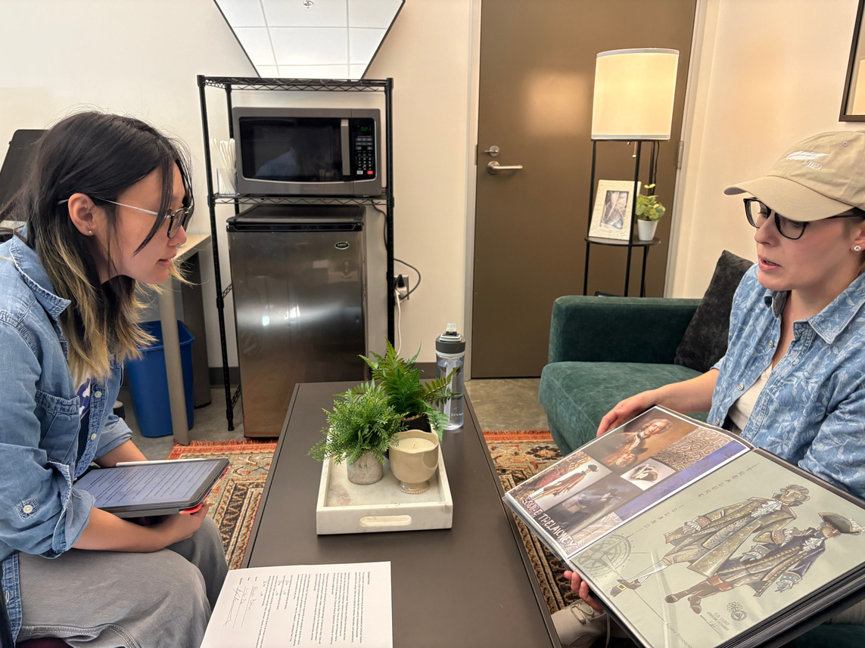

CMPCS 185
Team6
GR1: Needfinding - Interview Results - 1
Key Insights
Accuracy is a key evaluation criterion.
Design quality is judged not only by creativity. It’s more about how well references align with historical archive, script narrative, and material realities.
Communication and collaboration are central to successful design.
Synchronized and frequent conversations across departments are essential for aligning ideas and preventing misunderstandings, back-and-forth, and conflicts in the following steps.
Converting multimedia reference into visual design practice.
Inspiration and research come from multiple media, such as text, books, archives, and digital platforms. Costume designers rely on visuals to reason, decide, and communicate.
Timeline and speed strongly shape the design process.
Tight schedules compress ideation time and push designers toward faster, more flexible, and effcient tools.
AI is helpful, but only within clearly defined boundaries.
AI supports early exploration, but is not trusted for authorship, historical accuracy, or physically executable designs. It is difficult to control.

Slide 15
CMPCS 185
Team6
GR1: Needfinding - Interview Results - 1
Key Insights
She needs to ensure the accuracy and credibility of references.
She needs to interpret and translate multimedia research into visual design thinking.
She needs to collect and revisit inspiration in a low-pressure, ongoing way.
She needs databases and file systems to support design and collaboration.
She needs clear and synchronized communication across disciplines.
She needs to work efficiently under tight timelines and multitasking conditions
She needs to ensure designs are physically executable in the real world

Slide 16

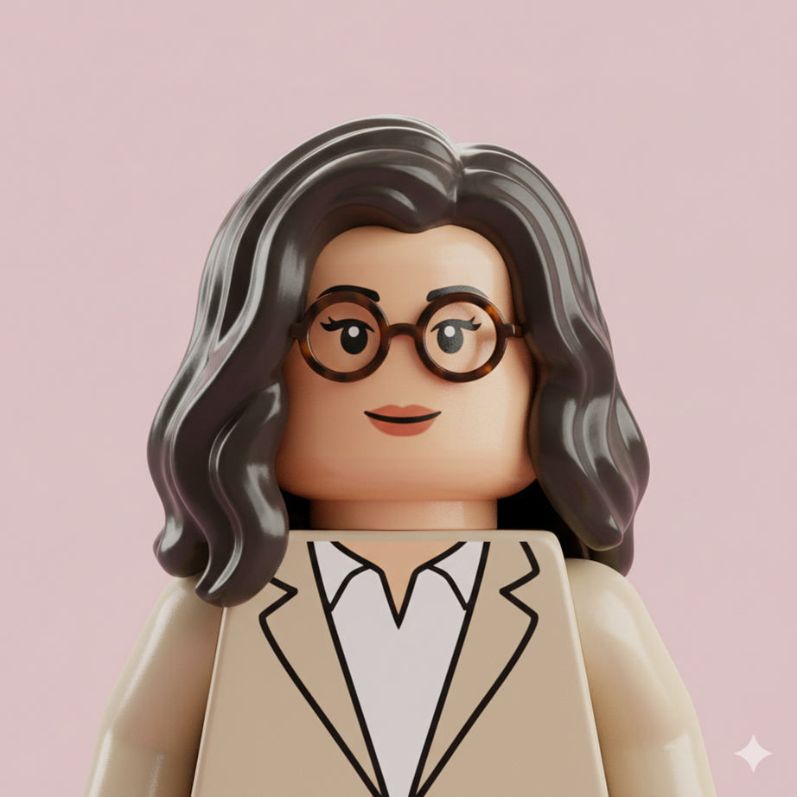

CMPCS 185
Team6
GR1: Needfinding - Interview Results - 2
Mei
UI & UE designer
Mobile Game Company
“In early stages, I use AI to quickly generate rough visuals to check whether the direction feels right. ”
“One inconvenience is that I often have to try multiple AI tools in parallel. I wish these tools were integrated so I could generate results from three or four AIs at once, choose the one I like, and then let all of them continue iterating.”

Slide 17

EMPATHY MAP
EMPATHY MAP
“ We use ‘1 + n’ mindset — ‘1’ is planner requirement, and ‘n’ is what we add through brainstorming.”
“Planner often ask to combining multiple design options which often ruins the result.”
“Planners lack visual imagination, they need to see it first, and only then realize it doesn’t actually work.”
AI is powerful but inherently unpredictable and unstable.
AI is valuable when efficiency is needed or when manpower is limited.
Reference-seeking is a fundamental part of ideation.
Design work is iterative and accumulative even when AI is “Designing”.
Non-visual stakeholders rely on concrete visuals to evaluate design decisions.
“During ideation, my favorite part is brainstorming.”
“What we’re making is a product, not art.”
“Product have clear set of requirements”
SAY
THINK
Generated image quality emerges through human selection and refinement, not from a single AI generation
“AI outcomes are unpredictable and luck-dependent.”
Different AI tools should be combined strategically to leverage their complementary strengths.
AI is perceived as an extension of traditional reference by generating options - rather than a replacement for human judgment in design thinking.
Design work requires aesthetic judgment, even when it is framed as product work rather than art
“Nano Banana generally has a more refined and visually pleasing style.”
“Some domestic tools are more creativity-oriented, like Jimeng or Doubao.”
“It would be great if these tools could be integrated.”
AI generation is inherently unpredictable, even when tool capabilities are known.
Artistic refinement after brainstorming cannot rely solely on AI requires manual step-by-step design.
“I often have to try several AI tools at the same time, it takes a lot of time.”
“Try several AI because they have different capabilities — creativity, refinement, or visual style.”
“It’s very hard to predict the results beforehand.”
“Doubao is fast and follows prompts well, but its aesthetics aren’t great.”
Iteration benefits from preserving and reusing promising intermediate results.
“Using AI in the refinement stage is different, because many artistic decisions are subjective and personal.”
Subjective and personal artistic decisions can only be effectively expressed using manual approaches
AI’s role is to support exploration, not to make final creative decisions.
All generated results can retain value for and beyond the immediate task.
“I want to see three or four results at once, choose one, and then continue from there. ”
Unpredictability in AI generation creates significant time overhead.
“AI is essential in the brainstorming stage”
“In brainstorming it’s like looking for references at work, a tool that helps me shift my thinking and get new ideas.”
“During refinement, I always have to manually adjust the final result ”
“In terms of efficiency of using AI in refinement, it can get me about 60% of the way there.”
Seeing multiple visual options side by side supports faster and more confident selection.
Exploration must be time-bounded to remain efficient.
AI is most valuable during brainstorming, where it helps expand thinking and surface unexpected ideas.
“In good cases, one or two attempts are enough.” “In bad cases, it can take several days without any strong results.”
Combining elements does not automatically result in good design.
Trying multiple AI tools is necessary but inefficient.
AI can improve communication efficiency by rapidly visualizing ideas and reducing ambiguity during discussions. Further enhance iteration efficiency
AI is essential for brainstroming
Receives requirements from the planner and builds an initial UE framework.
When UE framework is ready, then communicate with planner
Communicate using demos, rough sketches, UE scenes, or images to align on direction, rather than creating a full prototype.
Some UI scenes would normally rely on illustration support, but due to limited illustration resources, we use AI early to generate rough visuals and validate the direction.
We use AI during meetings.
When the planner describes a desired “feeling,” quickly generating visuals on the spot to align understanding and direction.
Relieved when AI accelerates ideation and communication
Hopeful about better tools.
Start design directly or first use AI to explore ideas and do brainstorming.
AI is mostly used in brainstorming phase as a supporting tool
Runs 3 AI tools in parallel , compares the results, and continues refining the most promising output—either within the same tool or by feeding it into other AI tools.
All the images generated during the process is documented and useful ones are marked
Search for references during brainstorming, from design platforms like Pinterest and Behance, similar games, events, or systems.
Frustrated and misunderstood when planners dilute design decisions and only recognize visual intent after seeing concrete examples.
I still rely mostly on Photoshop and Adobe Illustrator and do step-by-step design.
Excited and energized during brainstorming.
Uses images from Pinterest or suitable reference image as input materials for image-to-image generation
Impatient with prolonged trial-and-error.
Uses text-to-image generation when no reference images are available
Overwhelmed by tool switching and time costs.
Uses text-based AI tools to get keywords or prompts and feeding them into one or many AI tools for further image generation
Sets a personal deadline for exploration using AI, Stop if no promising result appears within a fixed time window
Maintains and continuously expands a personal image library, organizing accumulated outputs over time.
Anxious about the unpredictability of AI outcomes.
When using Pinterest, I repeatedly layer and refine search keywords to narrow down the results.
Generate an initial result in Jimeng and then refining it in Nano Banana for better aesthetics.
Iterates by mixing and switching between different AI tools
Keeps separate Pinterest accounts for work and personal use.
‘train’ the account
DO
FEEL

Slide 18
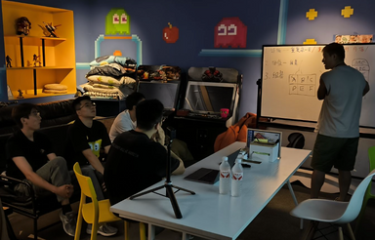
CMPCS 185
Team6
GR1: Needfinding - Interview Results - 2
Key Insights
Brainstorming is where AI creates the most value
AI accelerates ideation but introduces uncertainty and overhead
AI partly shifts effort from creation to decision-making
AI can generate options, but design quality comes from human judgment and intervention.
Effective workflows rely on comparing multiple alternatives and iterations
Intermediate outputs can have long-term value beyond a single task
Tool fragmentation disrupts creative flow
Tool choice is contextual, not hierarchical

Slide 19

CMPCS 185
Team6
GR1: Needfinding - Interview Results - 2
Key Needs
She needs AI tools that prioritize fast, low-friction exploration during early ideation.
She needs to manage time, effort, and uncertainty during exploration, maintaining a sense of control rather than being driven by AI unpredictability.
She needs tools that help her choose, discard, and combine ideas, instead of simply generating more outputs.
She needs part of generated images to persist as reusable assets
She needs a unified and continuous workflow, minimizing tool switching and context loss to preserve creative flow.
She needs mechanisms to externalize design intent and aesthetic judgment into visible, manipulable representations, so intent expressed through text or images can be inspected, adjusted, and used to intentionally steer generative outcomes

Slide 20

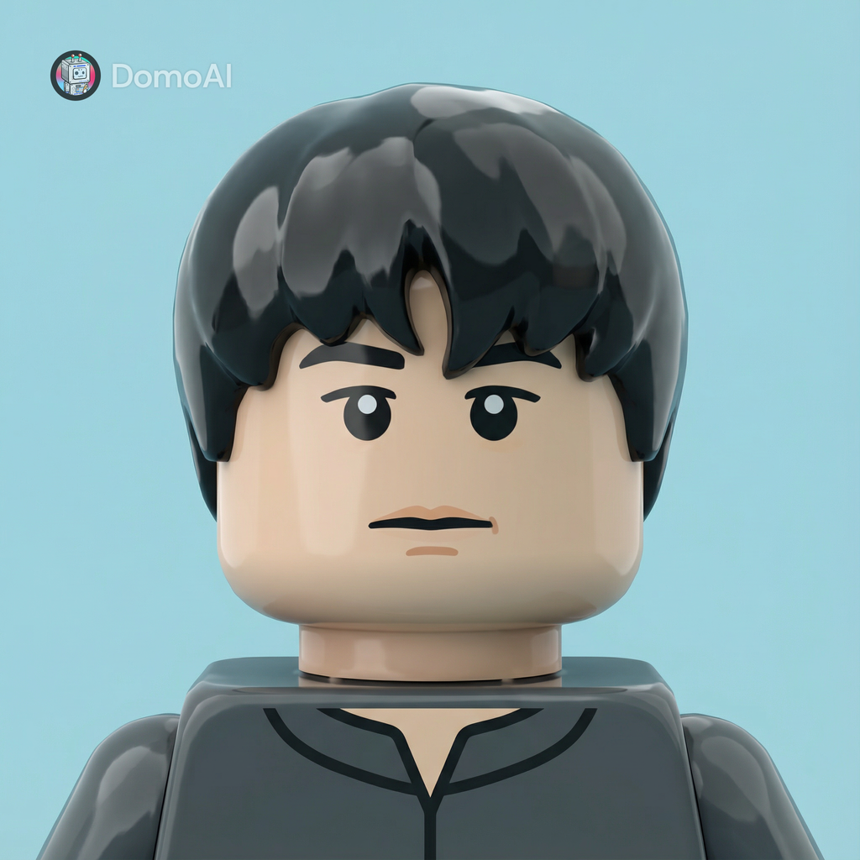

CMPCS 185
Team6
GR1: Needfinding - Interview Results - 3
Ming
Animator & Vfx designer Mobile Game Company
“I usually use AI for demos. By feeding early concept images with prompts, I can avoid the high upfront cost of traditional animation setup.”
“I usually set a clear time limit for AI. If it doesn’t produce a usable result within that window, I simply abandon it.”

Slide 21

EMPATHY MAP
“Looking at competitor projects helps a lot.”
Iteration is necessary to reach the right balance
Inspiration rarely comes from the first search result
“I usually start by making a demo.”
“Pinterest needs to be searched iteratively.”
SAY
THINK
Jumping straight into full production is risky and costly
Good ideas often come from analyzing what already works
Visual effects must balance creativity, performance, and product needs
“We need to align with planning and programming early.”
Aligns with planners multiple times during the concept phase
“Explaining artistic value to planning can be frustrating.”
“We usually communicate rhythm by sound.”
“I separate my work Pinterest account from my personal one.”
Keywords and references must be refined gradually
Early alignment saves time and avoids rework
“It’s a process of mixing, adding, and then reducing.”
Rhythm and feeling are more important than static visuals
Time constraints shape the depth of exploration
Artistic ideas often need justification within product logic
“Complex character animation is still hard for AI.”
Control and consistency matter more than raw speed in animation workflows
“AI’s impact on animation is still relatively limited.”
“AI results usually need further adjustment.”
AI is not yet reliable enough for core animation production
Fallback to traditional methods is always necessary
AI is better suited for early exploration or simple visual effects
Different departments benefit from AI in very different ways
“AI is expected to help with efficiency and creativity, but mostly efficiency.”
“If it doesn’t work quickly, I just stop using it.”
“I usually give it a very short time window.”
Reliability matters more than novelty
“AI works best for environmental effects.”
“AI is still quite unpredictable.”
AI should not disrupt established production habits
Manual animation offers more control and predictability
Creates quick demos to test direction and feasibility
Tests demos in-game for performance and fit
Uses tools like Photoshop, Spine, Unity, and After Effects
Follows links from images to external sources for deeper exploration
Patient but selective during inspiration searching
Comfortable with informal, embodied communication
Iterates by adding elements first, then refining and simplifying
Cautious about wasting time and production resources
Curious and observant toward industry trends
Enjoys experimentation and visual exploration
Focused on meeting deadlines over experimenting
Uses sticky notes and hand sketches for fast group ideation
Iteratively searches on Pinterest by adjusting keywords
Communicates animation rhythm verbally or through sound cues
Pressured by deadlines but accustomed to time-driven workflows
Gathers references from competitor games, YouTube, and Pinterest
Visualizes ideas quickly in Photoshop when needed
Plans work strictly around deadlines and time checkpoints
Aware of industry shifts and workforce changes driven by AI
Cautious and skeptical toward AI reliability
Frustrated by limited artistic authority in decision-making
Relieved when AI can reduce workload for repetitive or atmospheric effects
Aligns with planners multiple times during the concept phase
Experiments with AI mainly before the demo stage to test directions
Abandons AI workflows if results are not satisfactory within the time limit
Curious about AI’s rapid progress outside the core animation pipeline
Unwilling to gamble production quality on uncertain tools
Collaborates closely with planners, programmers, and other artists
Uses AI for simple 3D transitions or keyframe interpolation
Refines AI-generated results
Uses AI only in very specific scenarios
DO
FEEL

Slide 22
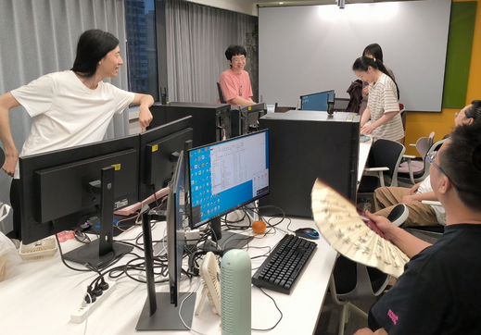
CMPCS 185
Team6
GR1: Needfinding - Interview Results - 3
Key Insights
AI is more effective for exploration than final production
Control and predictability are more important than raw efficiency
In production workflows, designers prioritize controllable and reliable results over speed gains from AI.
AI performs better in pattern-based effects than complex character animation
AI is more effective for 2D effects and natural phenomena (e.g., fire, smoke, loops) than for complex 3D character motion, which requires precise control and narrative continuity.
AI enables individual production at near-studio quality
A practical AI pipeline is multi-tool and iterative, not one-shot generation

Slide 23
CMPCS 185
Team6
GR1: Needfinding - Interview Results - 2
Key Needs
He needs tools that enable fast idea exploration with strong control and predictable outputs that behave reliably within production workflows.
He needs AI tools optimized for areas where AI already demonstrates clear strengths.
He thinks individual creators need workflows that allow them to efficiently combine multiple tools and achieve near–studio-quality results.
He needs support on step-by-step iteration, versioning, and handoff between tools rather than one-shot generation.

Slide 24


CMPCS 185
Team6
GR1: Needfinding - Interview Results - 4
Joe
Digital Fabrication & Sculpture Designer, Artist, President of a Manufacturing Studio
“A lot of what I do is dealing with constraints and possibilities.”
“I’m fascinated by AI, but I don’t find it very useful for my work yet.”

Slide 25

EMPATHY MAP
“I’m thinking first about the environment it’s going into.”
“I knew what I wanted, and I worked with a design engineer.”
“I’m not personally doing that work.”
“I enjoy making marks.”
“The work is based on what I want to do.”
Design starts from spatial experience, not tools
Clear intent matters more than technical execution
Inspiration comes from existing references, not a blank slate
Material, fabrication, and software actively shape ideas
“A single still image tells you so little.”
SAY
THINK
Materials have different “personalities”
Constraints are part of the creative process
“I really just need the right client.”
“I’ve been working in anodized aluminum since childhood.”
“The ideas come from the material itself and the possibilities of the software.”
“The main challenge is that I’m ambitious.”
The ideas “come from nature, also come from art.”
Visual qualities are conceptually powerful
Long-term practice builds intuition
Specific environment defines the work
Process marks carry meaning and should remain visible
Uncertainty about final placement limits design quality
“You can almost scale any idea if you break it into modules.”
“I find the machining very beautiful and interesting.”
Spatial experience matters more than static images
“These models are very important for my process.”
“Photography can’t do that (showing the changing of the appearance).”
Knowing where a piece will live enables bigger ideas
“People have a hard time envisioning scale.”
“There isn’t a single right answer.”
Misunderstand-ings usually come from visualization gaps
Physical demos communicates more than verbal explaination
Light changes how a piece is perceived over time
Constraints are a source of creativity, not a limitation
“A lot of what I do is dealing with constraints and possibilities.”
“My favorite thing to do is create work for a specific environment.”
The work only fully reveals itself at the final stage
Technical limits are mostly solved; scale is the real challenge
“You don’t really know what you’re looking at until it’s finished.”
“I’m fascinated by AI, but I don’t find it very useful for my work yet.”
“A lot of what I do is dealing with constraints and possibilities.”
Art and industrial comstrains “is becoming less and less of a trade-off.”
“I’m asking what makes the constraints interesting.”
Modularity makes large-scale work possible
Scale, light, and presence are hard to imagine without seeing
Trust and reputation matter more than self-promotion
New materials are opportunities, not obstacles
AI can’t achieve accuracy and fidelity
Defines the desired spatial and emotional effect
Communicates intent to others who handle technical work
Makes high-level decisions about form, structure, and surface
Looks at nature and artworks for visual qualities
Iterates through making and surface testing
Grounded by deep material experience
Confident in his conceptual authority
Comfortable not doing hands-on technical work
Confident in learning through making and iteration
Engaged with material and process
Uses scale models, 1:1 printouts, and material samples
Curious and observant
Designs work for specific spaces and light conditions
Adjusts scale and finish based on the environment
More confident with clear spatial constraints
Studies other artists’ work
Collaborates with architects to define constraints
Places representations directly in the actual space
Motivated by site-specific commissions
Observes how natural light shapes the perception of the work
Relieved when risk and uncertainty are reduced
Proud of having the freedom and resources to work this way
Careful and risk-conscious with expensive work
Confident from decades of industrial design experience
Adapts past experience from large projects to future work
Evaluates the work only when it is finished and installed
Experiments with fabrication parameters to explore variation
Reassured when clients can see and feel the work
Reduces hand-finishing to preserve machining traces
Relies on galleries, collectors, and architects for commissions
Comfortable with uncertainty in outcomes
Builds large pieces from repeatable modules
Attentive to subtle environmental changes
Motivated by subtle, often unseen details
Excited and energized by learning something new
Eager to find the right commissions.
Experiments with AI for visualization but doesn’t prefer it
Experiments with fabrication and finishing
Archives models to understand and reflect on past work
Curious but skeptical about AI’s value for fabrication work
DO
FEEL

Slide 26
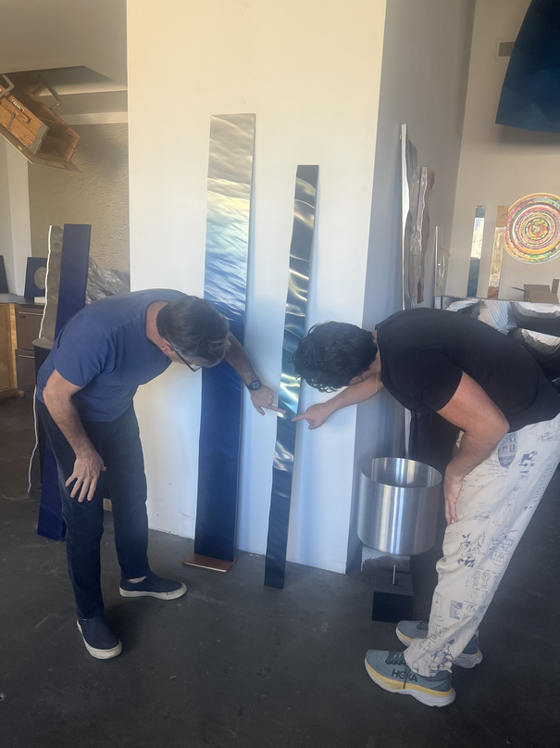
CMPCS 185
Team6
GR1: Needfinding - Interview Results - 4
Key Insights
Designer as Owner (Extreme Case)
Because he owns the factory and controls production, he can design without negotiating many industrial constraints. As a result, his ideas are driven more by intent than feasibility, which differs from most designers who work within organizational limits.
Design medium is physical
For him, scale, light, and spatial presence can only be understood through physical, in-situ representations. Verbal explanations, drawings, and even digital renders are secondary.
Generative Constraints
Long-term material expertise and decision-making power allow constraints (such as machining marks, modularity, and fabrication limits) to be reframed as aesthetic opportunities rather than trade-offs.
Scale are limited by commissions
His main challenge is not tools or process, but finding the right patrons and commissions that match his desired scale of work.
Shared understanding early
Good design comes from making sure everyone understands what will be built early, instead of fixing misunderstandings after fabrication.
Limitations of AI
AI-generated imagery is seen as unreliable because it alters form, light, and reflectivity, which are central to his practice. There is a mismatch between current AI tools and material-driven design workflows.

Slide 27
CMPCS 185
Team6
GR1: Needfinding - Interview Results - 4
Key Needs
He needs tools that help communicate scale, material, and light accurately to clients and architects early.
He needs representations that preserve physical fidelity rather than abstract or stylized outputs.
He needs workflows that work with real sites, where the context shapes the design decisions.
He needs tools that reduce misalignment without limiting creative authority or control.
He needs technologies that respect craftsmanship and material knowledge instead of replacing them.

Slide 28
CMPCS 185
Team6
GR1: Needfinding - Key Learning
Key Learnings
Design ideation succeeds through communication and mutual understanding. | Inspriation is collected accumulatively and continuously over time.
AI is most valuable in early exploration, but becomes less controllable as ideation progresses. | Digital tools should support predictable, low-friction exploration.
Using AI in ideation process is shifting labor from making to deciding. | Time management and multitasking are crucial.
A personal database & library enables systematic knowledge building & rapid ideation. | Human agency is central for designers. AI should assist intention.

Slide 29

CMPCS 185
Team6
GR1: Needfinding - Next Steps
What’s Next?
Additional Needfinding:
Conduct interveiws with designers from other disciplines.
Generate HMW Questions
Focus on helping designers judge, compare, communicate, and stay in control, rather than improving raw generation quality.
How do they communicate their ideas and collaborate?
How inspiration is collected over time vs. under deadlines
Where AI currently fits and where it fails in their workflows
Moments where designers feel in control vs. constrained by tools.
Explore Experience Prototypes
Refine POVs
Test how systems can help designers steer, revise, and bound AI-driven exploration without breaking creative flow.
Frame POVs around designers as active decision-makers, not passive operators of automated tools.

Slide 30
Thank You
Needfinding Report
Team 6
CMPSC 185
Xue Gao, Jintong Yang, Yanxiu Jin
Human-Computer Interaction

